Slide 1

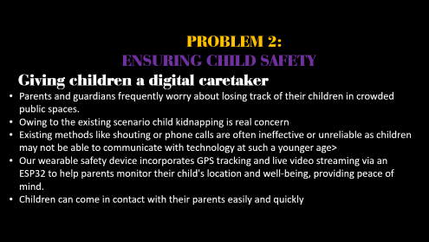
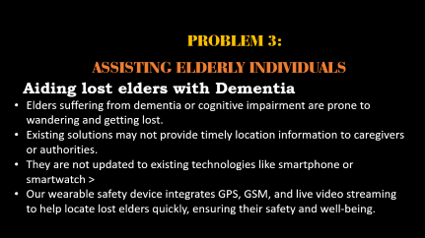
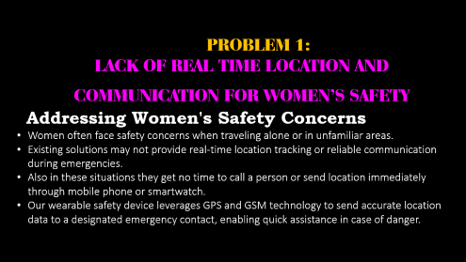



PROBLEMS WE ARE SOLVING

Slide 2
PROBLEM 1:
LACK OF REAL TIME LOCATION AND COMMUNICATION FOR WOMEN’S SAFETY
Addressing Women's Safety Concerns
Women often face safety concerns when traveling alone or in unfamiliar areas.
Existing solutions may not provide real-time location tracking or reliable communication during emergencies.
Also in these situations they get no time to call a person or send location immediately through mobile phone or smartwatch.
Our wearable safety device leverages GPS and GSM technology to send accurate location data to a designated emergency contact, enabling quick assistance in case of danger.

Slide 3
PROBLEM 2:
ENSURING CHILD SAFETY
Giving children a digital caretaker
Parents and guardians frequently worry about losing track of their children in crowded public spaces.
Owing to the existing scenario child kidnapping is real concern
Existing methods like shouting or phone calls are often ineffective or unreliable as children may not be able to communicate with technology at such a younger age>
Our wearable safety device incorporates GPS tracking and live video streaming via an ESP32 to help parents monitor their child's location and well-being, providing peace of mind.
Children can come in contact with their parents easily and quickly

Slide 4
PROBLEM 3:
ASSISTING ELDERLY INDIVIDUALS
Aiding lost elders with Dementia
Elders suffering from dementia or cognitive impairment are prone to wandering and getting lost.
Existing solutions may not provide timely location information to caregivers or authorities.
They are not updated to existing technologies like smartphone or smartwatch >
Our wearable safety device integrates GPS, GSM, and live video streaming to help locate lost elders quickly, ensuring their safety and well-being.

Slide 5
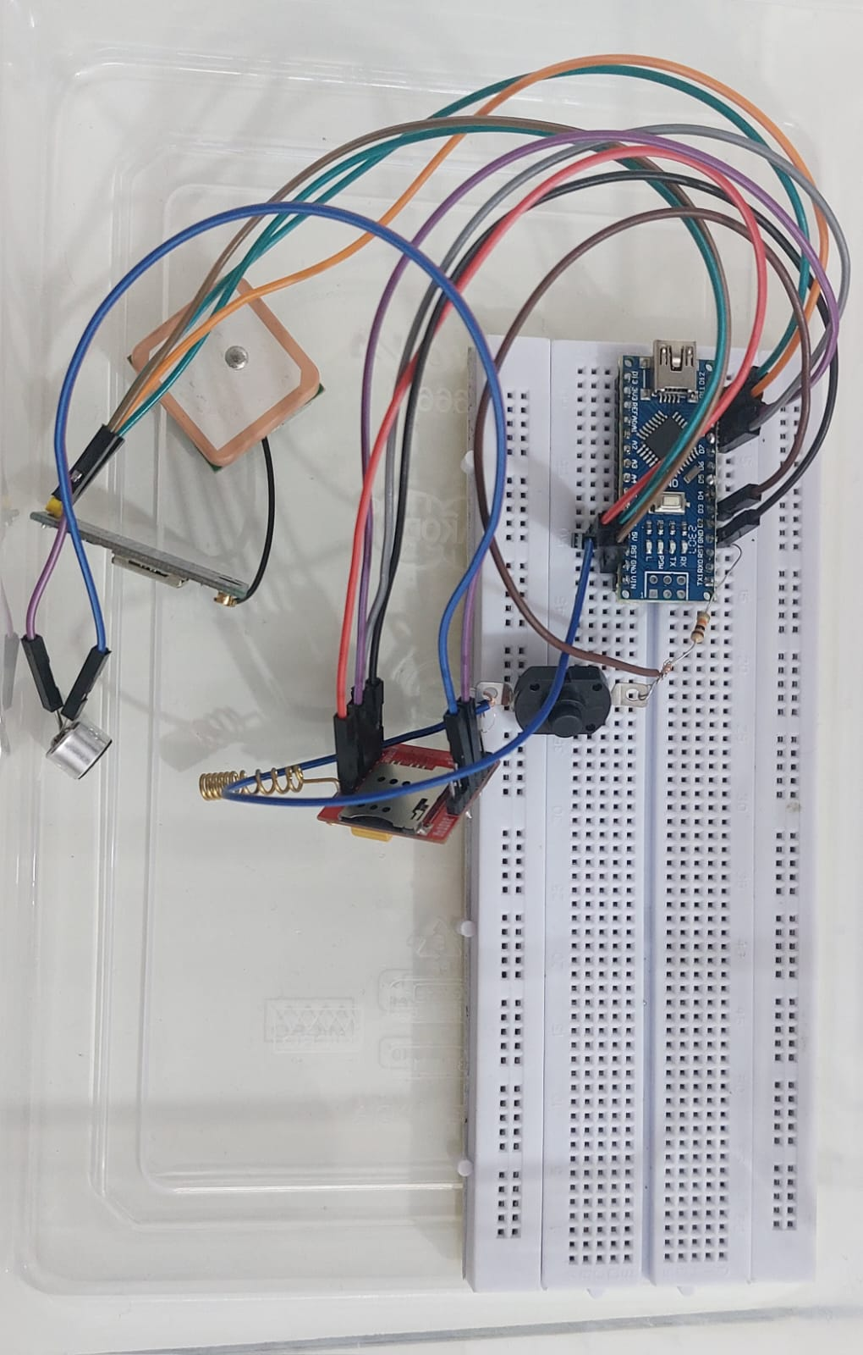
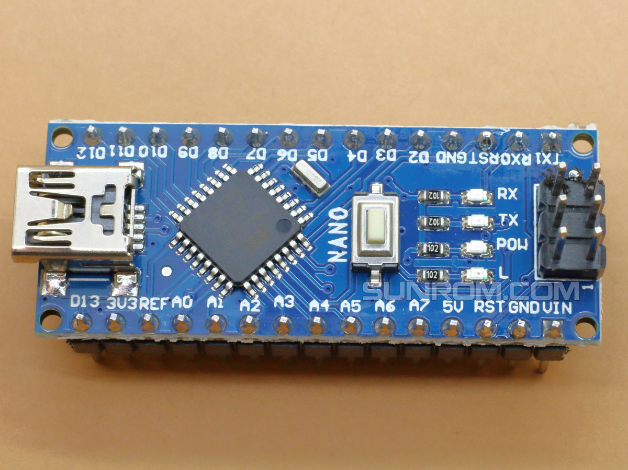
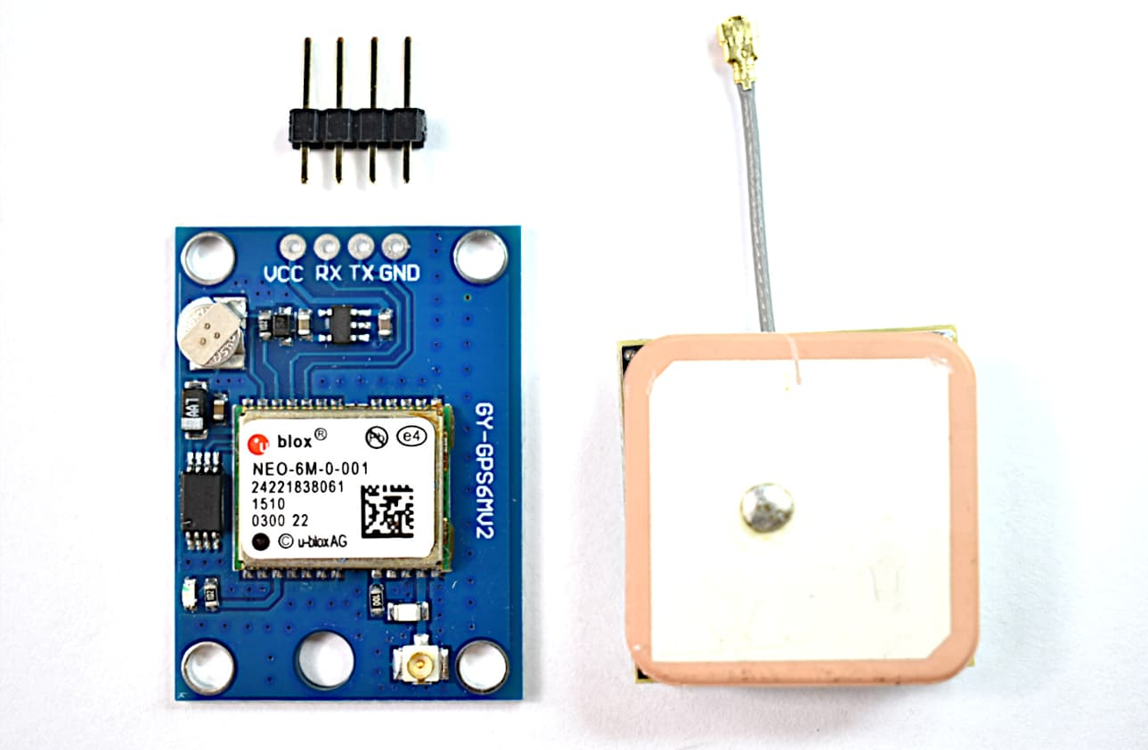
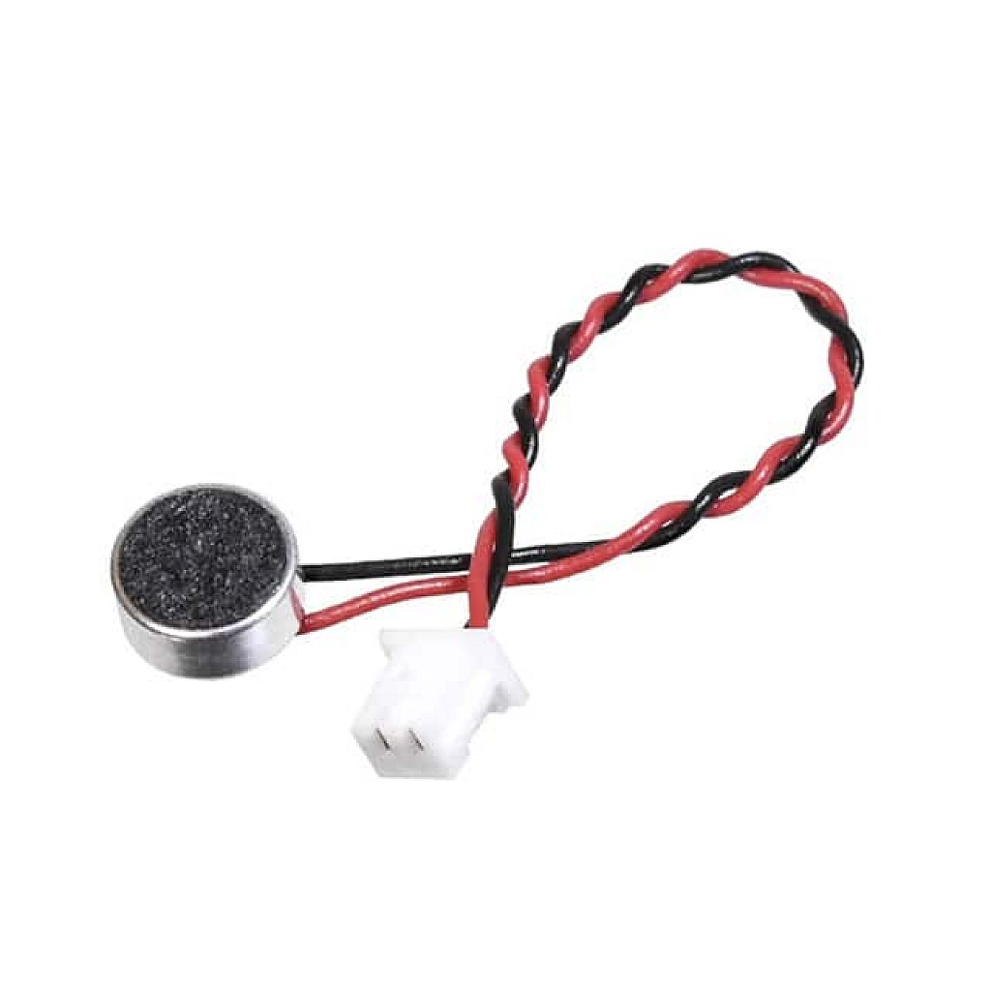
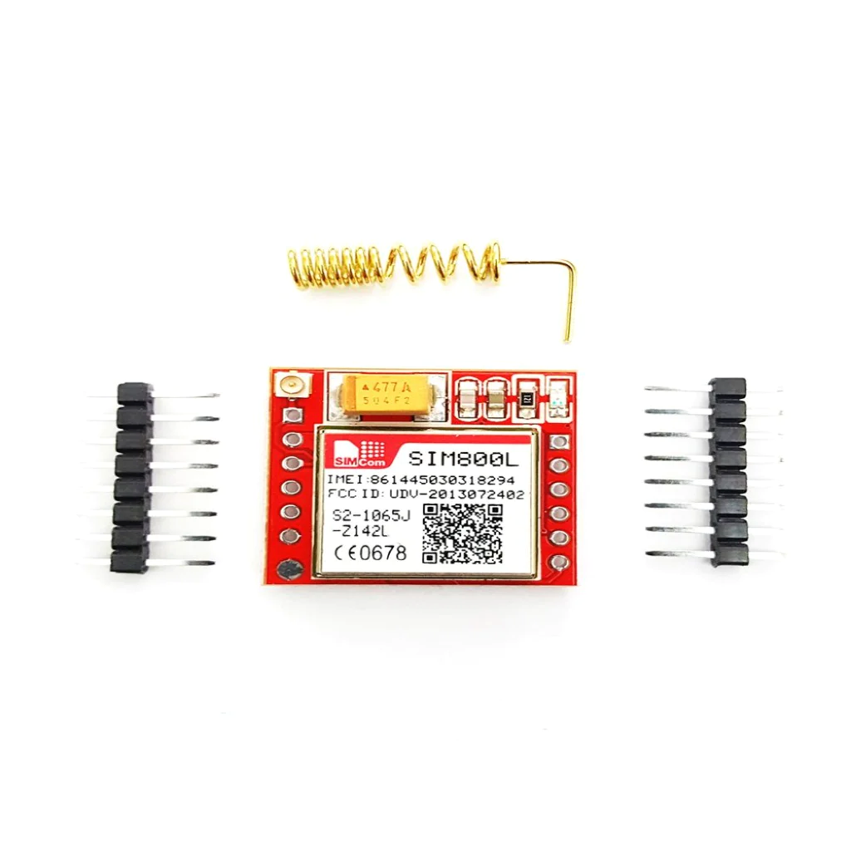
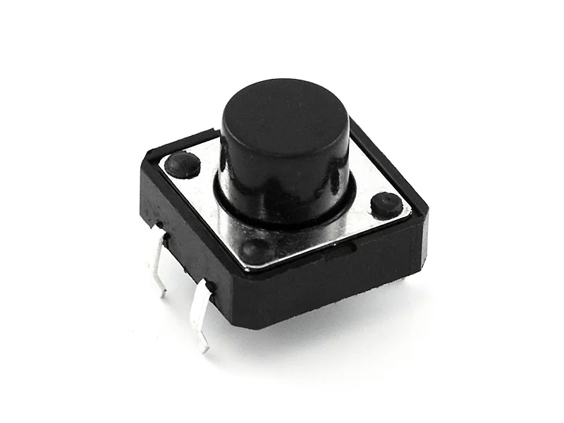
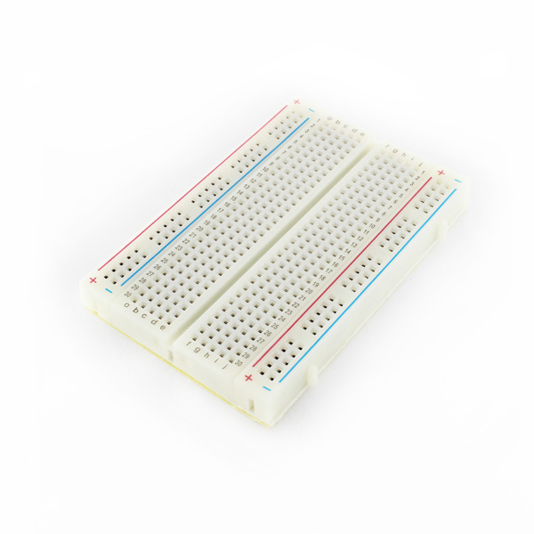
COMPONENTS USED
Main Components
In our wearable safety device project, we employ a range of key components to create a comprehensive safety solution. These components serve various functions, from location tracking and communication to real-time video streaming. Let's delve into each component's introduction and its specific role in enhancing safety for women, children, and the elderly."

Slide 6
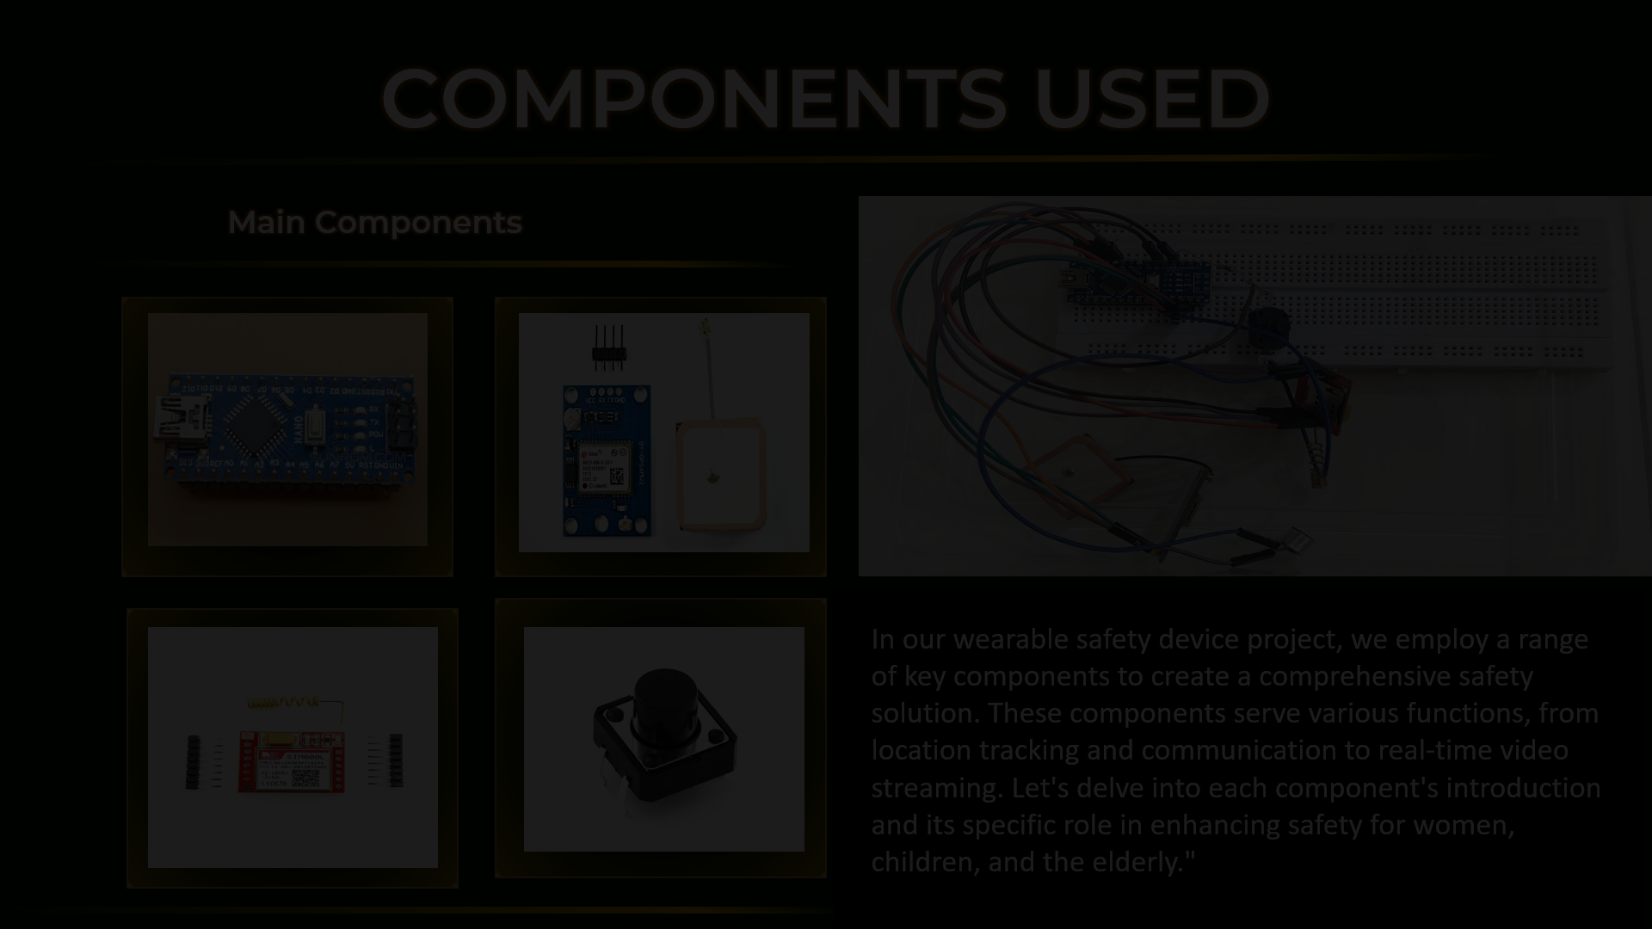
Arduino Nano
Introduction: The Arduino Nano is a compact, versatile microcontroller board known for its capability to control various electronic projects.
Purpose: In our project, the Arduino Nano serves as the central processing unit, responsible for managing data flow, executing algorithms, and coordinating communication between components. Its reliability and ease of use make it the ideal choice for controlling our safety device.
NEO-6M GPS Module
Introduction: The NEO-6M GPS Module is a small, high-precision Global Positioning System (GPS) unit, widely used for location tracking applications.
Purpose: This module is integrated into our wearable safety device to provide accurate latitude and longitude coordinates, enabling real-time location tracking. Its high accuracy ensures that emergency responders can quickly and precisely locate the device during critical situations, such as women's safety or aiding lost individuals

Slide 7
Arduino Nano
Introduction: The Arduino Nano is a compact, versatile microcontroller board known for its capability to control various electronic projects.
Purpose: In our project, the Arduino Nano serves as the central processing unit, responsible for managing data flow, executing algorithms, and coordinating communication between components. Its reliability and ease of use make it the ideal choice for controlling our safety device.
NEO-6M GPS Module
Introduction: The NEO-6M GPS Module is a small, high-precision Global Positioning System (GPS) unit, widely used for location tracking applications.
Purpose: This module is integrated into our wearable safety device to provide accurate latitude and longitude coordinates, enabling real-time location tracking. Its high accuracy ensures that emergency responders can quickly and precisely locate the device during critical situations, such as women's safety or aiding lost individuals
SIM800L GSM Module
Introduction: The SIM800L GSM Module is a compact communication device that supports Global System for Mobile Communications (GSM).
Purpose: It is essential in our project for sending SMS alerts with the device's location data to a designated emergency contact. This functionality ensures that help can be swiftly summoned during emergencies, serving the needs of women's safety, child safety, and aiding the elderly who have lost their way.

Slide 8
NEO-6M GPS Module
Introduction: The NEO-6M GPS Module is a small, high-precision Global Positioning System (GPS) unit, widely used for location tracking applications.
Purpose: This module is integrated into our wearable safety device to provide accurate latitude and longitude coordinates, enabling real-time location tracking. Its high accuracy ensures that emergency responders can quickly and precisely locate the device during critical situations, such as women's safety or aiding lost individuals
SIM800L GSM Module
Introduction: The SIM800L GSM Module is a compact communication device that supports Global System for Mobile Communications (GSM).
Purpose: It is essential in our project for sending SMS alerts with the device's location data to a designated emergency contact. This functionality ensures that help can be swiftly summoned during emergencies, serving the needs of women's safety, child safety, and aiding the elderly who have lost their way.
Trigger Button
Introduction: The Trigger Button is a user-activated physical button designed for emergency situations.
Purpose: Users can manually initiate emergency alerts by pressing this button, which is crucial for enhancing personal safety. It empowers the device wearer to signal distress and prompt a rapid response, making it a vital feature for the safety of women, children, and the elderly.

Slide 9
SIM800L GSM Module
Introduction: The SIM800L GSM Module is a compact communication device that supports Global System for Mobile Communications (GSM).
Purpose: It is essential in our project for sending SMS alerts with the device's location data to a designated emergency contact. This functionality ensures that help can be swiftly summoned during emergencies, serving the needs of women's safety, child safety, and aiding the elderly who have lost their way.
Trigger Button
Introduction: The Trigger Button is a user-activated physical button designed for emergency situations.
Purpose: Users can manually initiate emergency alerts by pressing this button, which is crucial for enhancing personal safety. It empowers the device wearer to signal distress and prompt a rapid response, making it a vital feature for the safety of women, children, and the elderly.
Microphone on GPS Module
Introduction: A small microphone has been soldered onto the GPS module, enabling audio input capabilities.
Purpose: This microphone allows for audio calling features, enabling two-way communication during emergencies. It enhances the device's functionality by enabling users to both send and receive audio information, further ensuring their safety and facilitating communication with emergency services or caregivers.

Slide 10
Trigger Button
Introduction: The Trigger Button is a user-activated physical button designed for emergency situations.
Purpose: Users can manually initiate emergency alerts by pressing this button, which is crucial for enhancing personal safety. It empowers the device wearer to signal distress and prompt a rapid response, making it a vital feature for the safety of women, children, and the elderly.
Microphone on GSM Module
Introduction: A small microphone has been soldered onto the GPS module, enabling audio input capabilities.
Purpose: This microphone allows for audio calling features, enabling two-way communication during emergencies. It enhances the device's functionality by enabling users to both send and receive audio information, further ensuring their safety and facilitating communication with emergency services or caregivers.
Bread Board
Introduction: A breadboard, solderless breadboard, or protoboard is a construction base used to build semi-permanent prototypes of electronics circuit..
Purpose: This Breadboards allow components to be easily inserted and removed. therefore, We used it to designs a simple module or circuit that they want to test, a breadboard provides a cheap and quick solution (designing a PCB just to test a simple circuit can be overkill and expensive).

Slide 11
Microphone on GPS Module
Introduction: A small microphone has been soldered onto the GPS module, enabling audio input capabilities.
Purpose: This microphone allows for audio calling features, enabling two-way communication during emergencies. It enhances the device's functionality by enabling users to both send and receive audio information, further ensuring their safety and facilitating communication with emergency services or caregivers.
Bread Board
Introduction: A breadboard, solderless breadboard, or protoboard is a construction base used to build semi-permanent prototypes of electronics circuit..
Purpose: This Breadboards allow components to be easily inserted and removed. therefore, We used it to designs a simple module or circuit that they want to test, a breadboard provides a cheap and quick solution (designing a PCB just to test a simple circuit can be overkill and expensive).

Slide 12
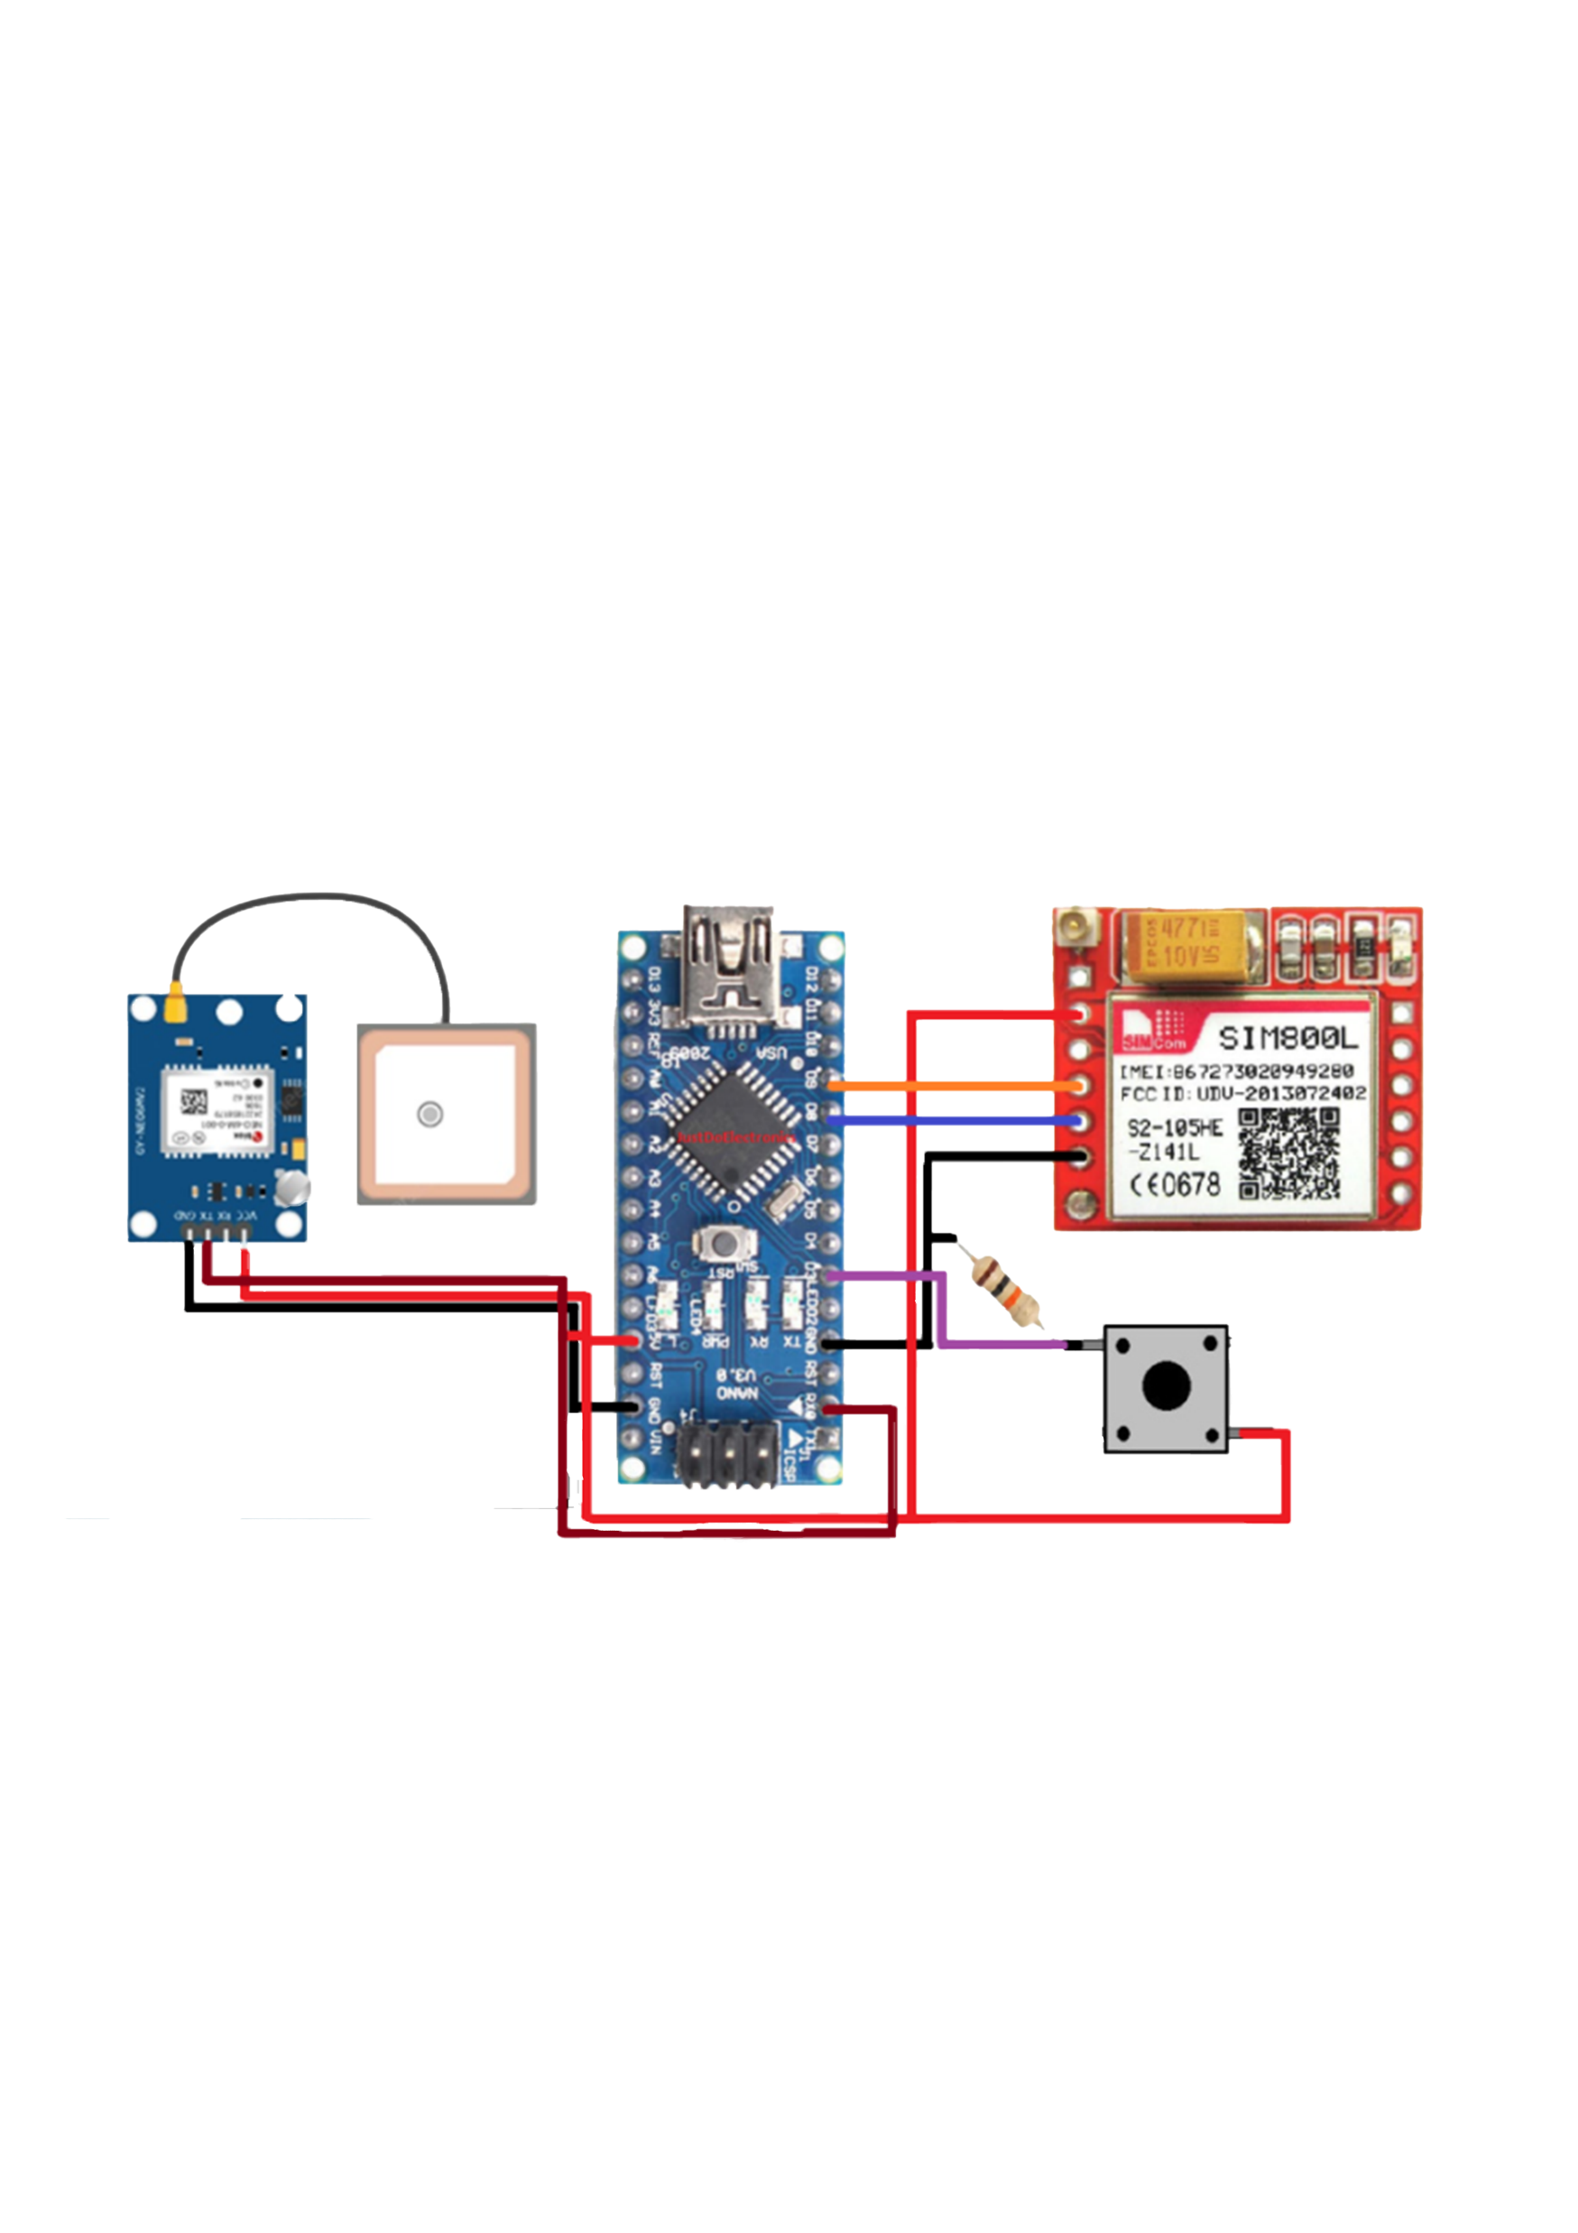
CONNECTIONS
SIM 800L GSM MODULE
VCC → 5v (ARDUINO NANO)
RXD → D9 (ARDUINO NANO)
TXD → D8 (ARDUINO NANO)
GND → GND (ARDUINO NANO)
MICP → MICROPHONE
MICN → MICROPHONE

Slide 13
CONNECTIONS
GPS NEO 6M
VCC → 5v (ARDUINO NANO)
RXD → D11 (ARDUINO NANO)
TXD → D10 (ARDUINO NANO)
GND → GND (ARDUINO NANO)

Slide 14
CONNECTIONS
ARDUINO NANO
5v → TRIGGER BUTTON
D3 → TRIGGER BUTTON
VIN → CELLS
GND → CELLS
RESISTOR BETWEEN GND(ARDUINO NANO) AND TRIGGER BUTTON(D3 SIDE)

Slide 15
WORKING
01
First of all code is uploaded to ARDUINO NANO using ARDUINO IDE SOFTWARE. Then power supply is given to ARDUINO NANO using lithium cells. When trigger button is pressed, ARDUINO retrieves live location from GPS NEO 6M.

Slide 16
WORKING
01
02
First of all code is uploaded to ARDUINO NANO using ARDUINO IDE SOFTWARE. Then power supply is given to ARDUINO NANO using lithium cells. When trigger button is pressed, ARDUINO retrieves live location from GPS NEO 6M.
The retrieved location is sent to registered mobile number via SMS using SIM 800L GSM MODULE. The operator at registered mobile number can click on location sent via SMS to open live location of devicde and can track the person in need.

Slide 17
WORKING
01
02
03
First of all code is uploaded to ARDUINO NANO using ARDUINO IDE SOFTWARE. Then power supply is given to ARDUINO NANO using lithium cells. When trigger button is pressed, ARDUINO retrieves live location from GPS NEO 6M.
The retrieved location is sent to registered mobile number via SMS using SIM 800L GSM MODULE. The operator at registered mobile number can click on location sent via SMS to open live location of devicde and can track the person in need.
Also a call is sent to same number. Through this call live audio can be heard by person at registered mobile number with the use of MICROPHONE. He/She can record this call for further use like to hand it over to police for evidences, etc.

Slide 18
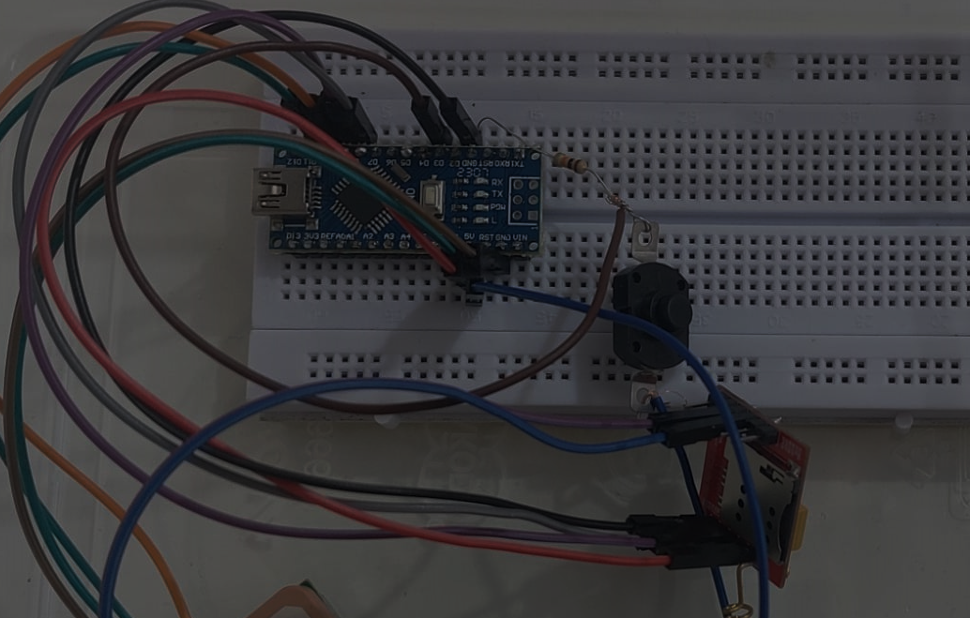

FEATURES OF EMERGENCY WEARABLE DEVICE
Real-Time Location Sharing: The device provides real-time GPS location updates.
Audio Call Capability: It enables audio communication through GSM.
Single Trigger Button: All functions are initiated by a discreet single button which is hidden and with single trigger ensuring quick actions. Hidden Design: The primary feature is hidden, ensuring discreet use in emergencies

Slide 19
FUTURE GOALS

Slide 20
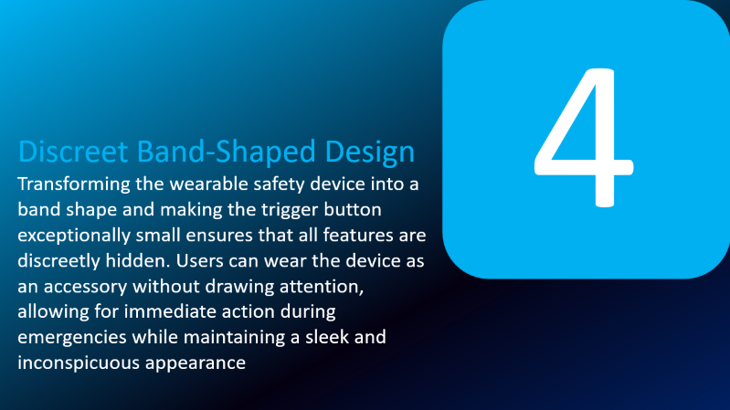
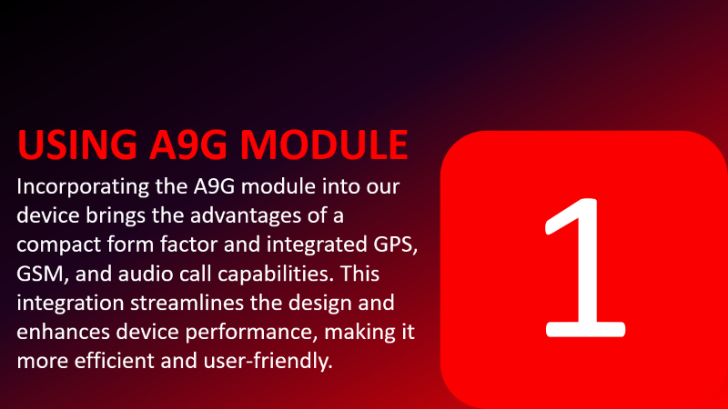
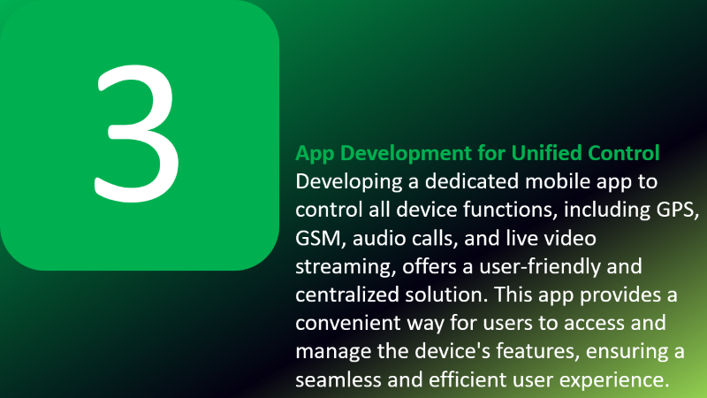
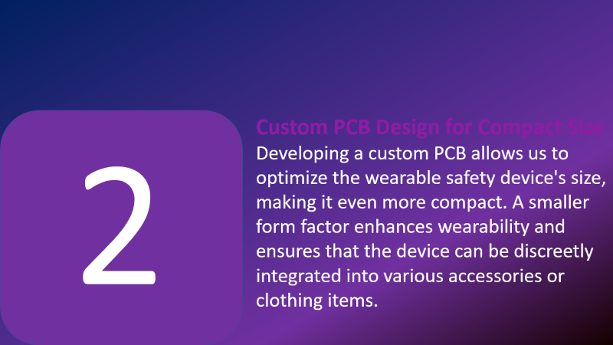


Slide 21
USING A9G MODULE
Incorporating the A9G module into our device brings the advantages of a compact form factor and integrated GPS, GSM, and audio call capabilities. This integration streamlines the design and enhances device performance, making it more efficient and user-friendly.
1

Slide 22
2
Custom PCB Design for Compact Size
Developing a custom PCB allows us to optimize the wearable safety device's size, making it even more compact. A smaller form factor enhances wearability and ensures that the device can be discreetly integrated into various accessories or clothing items.

Slide 23
3
App Development for Unified Control
Developing a dedicated mobile app to control all device functions, including GPS, GSM, audio calls, and live video streaming, offers a user-friendly and centralized solution. This app provides a convenient way for users to access and manage the device's features, ensuring a seamless and efficient user experience.

Slide 24
4
Discreet Band-Shaped Design
Transforming the wearable safety device into a band shape and making the trigger button exceptionally small ensures that all features are discreetly hidden. Users can wear the device as an accessory without drawing attention, allowing for immediate action during emergencies while maintaining a sleek and inconspicuous appearance.

Slide 25
6
HOW OUR PROJECT IS DIFFERENT FROM SMARTPHONE AND SMART-WATCHES
5
4
3
2
2
1

Slide 26
Dedicated Safety Functionality
6
Our device is designed with a singular focus on safety. Unlike smartphones or smartwatches, which have a wide range of features, your device is optimized for emergency situations. It includes a discreet trigger button for immediate response and integrates features like GPS, GSM, audio calls, and live video streaming for safety purposes.
5
4
3
2
2
1

Slide 27
Discreet and Hidden Design
6
Our device is specifically designed to be discreet and inconspicuous, with a small trigger button and a band-shaped form. This ensures that in urgent situations, you can call for help without drawing attention or alerting potential threats. Smartphones and smartwatches are more visible and might not provide the same level of discretion.
5
4
3
2
2

Slide 28
Faster and Easier Access
6
In stressful situations, accessing safety features on a smartphone or smartwatch might require navigating through multiple screens and apps, which can be time-consuming. Our wearable device simplifies this by providing quick access to critical safety functions through a dedicated button.
5
4
3
2

Slide 29
6
Unified Control
5
4
Our device aims to integrate all
safety features into a single app for streamlined control. Smartphones and smartwatches often involve switching between various apps and settings to access GPS, make calls, or initiate live streaming, which can be cumbersome in emergency scenarios.
2

Slide 30
6
Compact and Wearable
5
The compact size and band-shaped design of your safety device make it comfortable to wear and ensures that it's always within reach. Smartphones are usually carried in pockets or bags, which might not be as accessible during emergencies.
2

Slide 31
Extended Battery Life
6
Our safety device can be optimized for extended battery life, ensuring that it remains operational when needed. Smartphones and smartwatches have numerous power-hungry applications that can deplete their batteries quickly.

